Slide 1



Remittance Patterns and Economic Development
ANSIBLE GROUP

Slide 2
INTRODUCTION
Over the years, a remarkable increase in remittance inflows especially to developing countries has been reported with an estimate of $630 billion in 2021 and a current estimate of $860 billion for 2023 globally (World Bank-KNOMAD, 2023.
These funds represent a significant share of the Gross Domestic Product (GDP) in many recipient countries, where they are crucially utilized for essential needs such as food, education, healthcare, and business investments and it is thus expected that the positive implication of remittance inflow will outweigh any negative outcome in the recipient developing economy.

Slide 3

PROBLEM
01
Economic impacts of remittance are poorly measured.
02
The lack of a globally acceptable framework inhibits consistent monitoring and projections, crucial for upholding policies that ensure a consistent increase in remittance inflow to developing economies.

Slide 4
AIM OF PROJECT
01
Assessing the remittance recipient trends featuring the top 10 countries based on 2023 estimated report
02
Evaluating the effect of remittance on economic development through key indicators such as GDP, HDI, HPI, MPI, etc.
03
Leveraging artificial intelligence through machine learning to train models for corresponding prediction, as well as, improving the accuracy
04
Deploying trained model

Slide 5
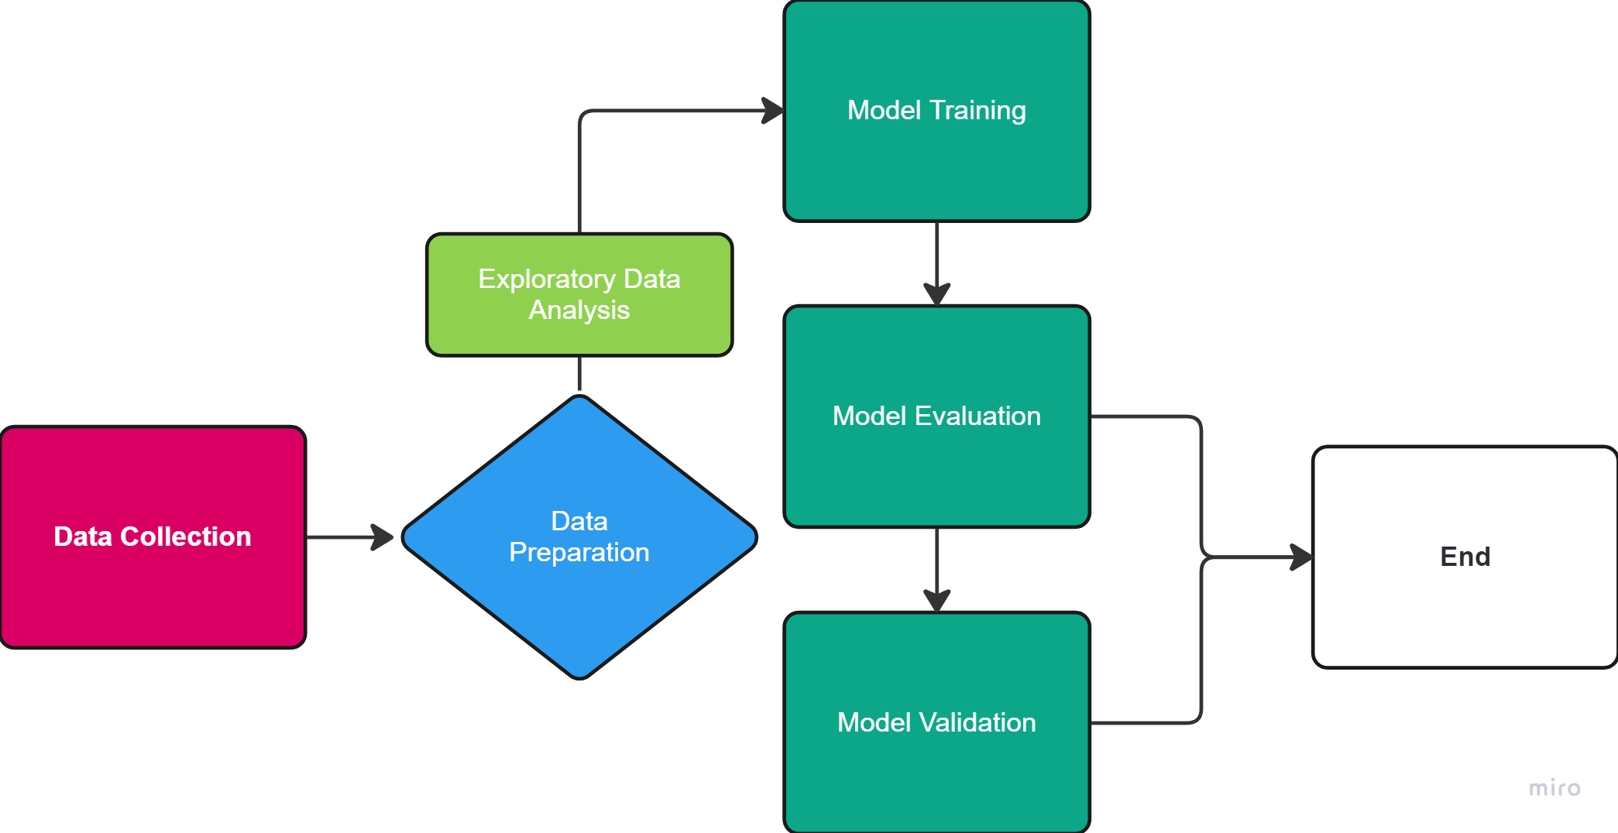
METHODOLOGY

Slide 6
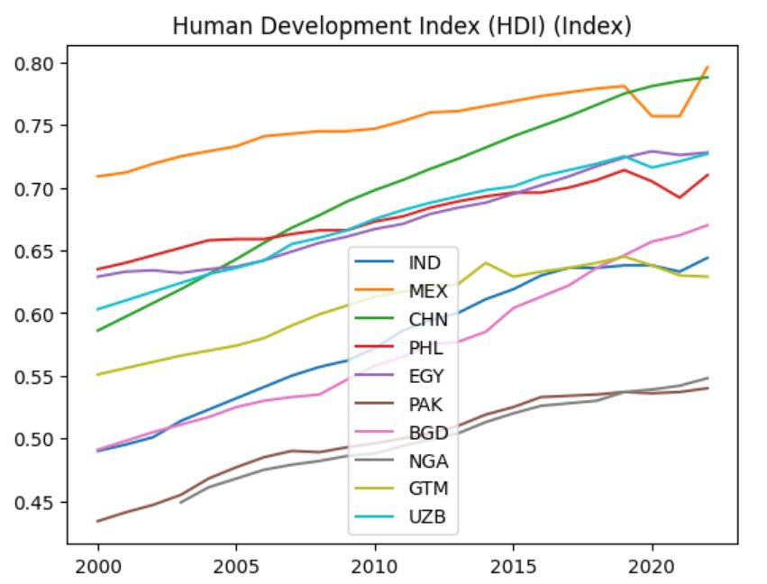
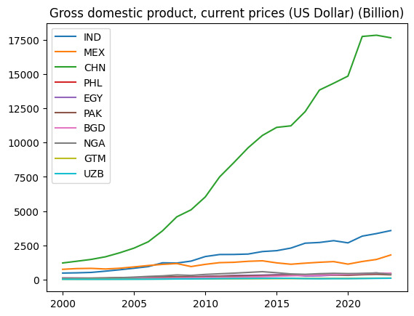
EXPLORATORY DATA ANALYSIS

Slide 7
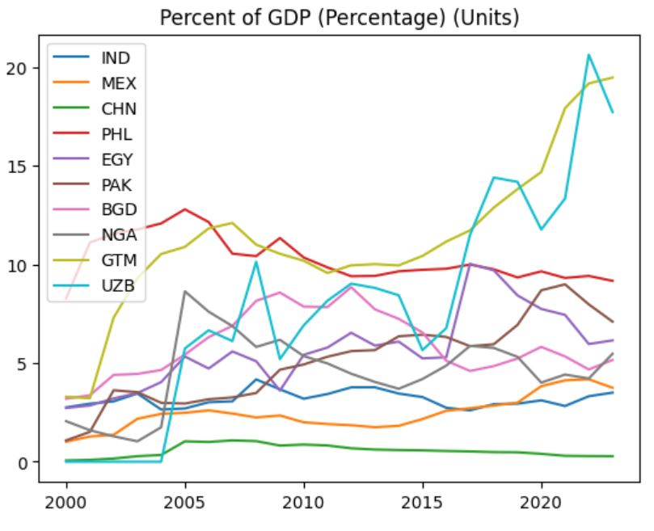
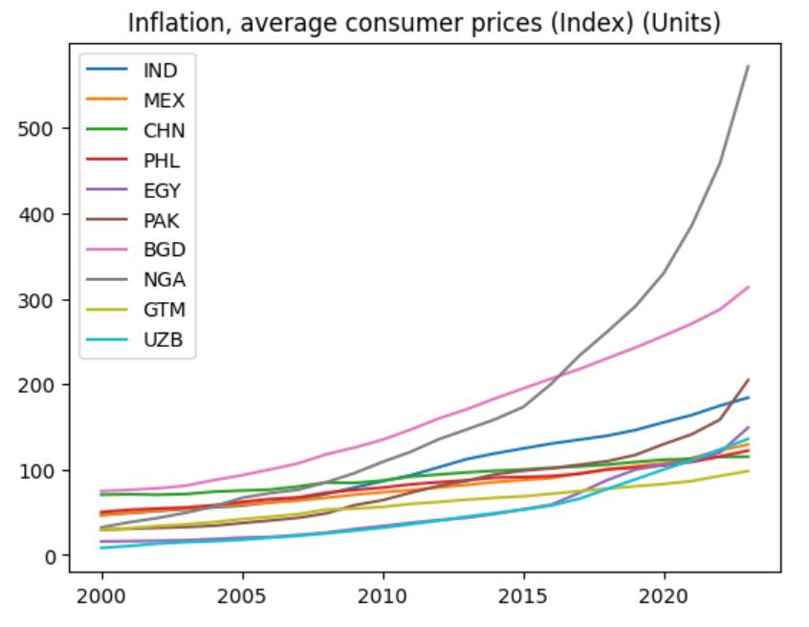
EXPLORATORY DATA ANALYSIS (cont.)

Slide 8
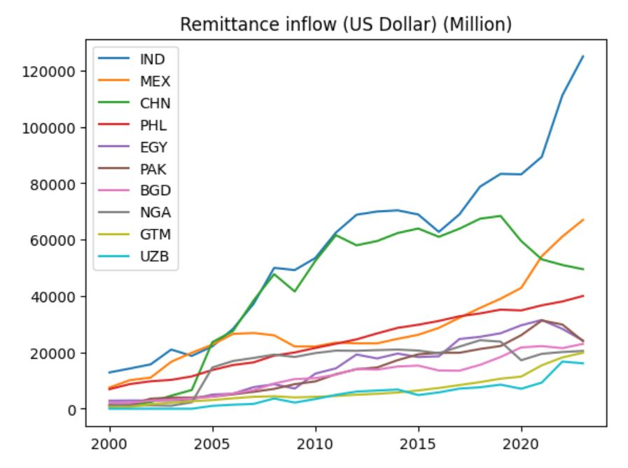
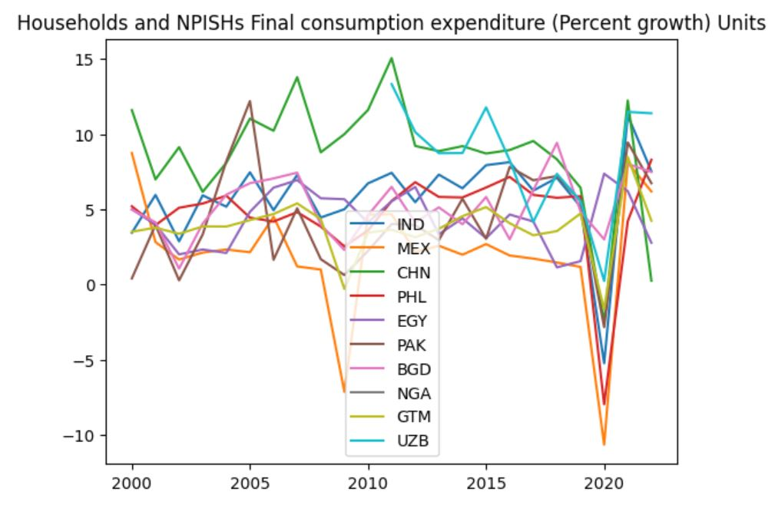
EXPLORATORY DATA ANALYSIS (cont.)

Slide 9
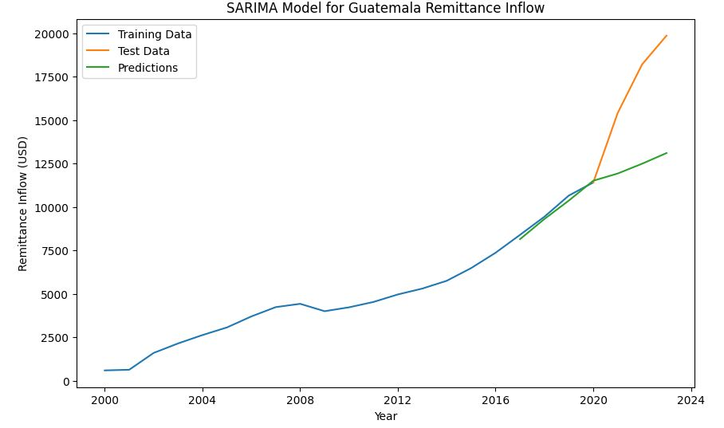
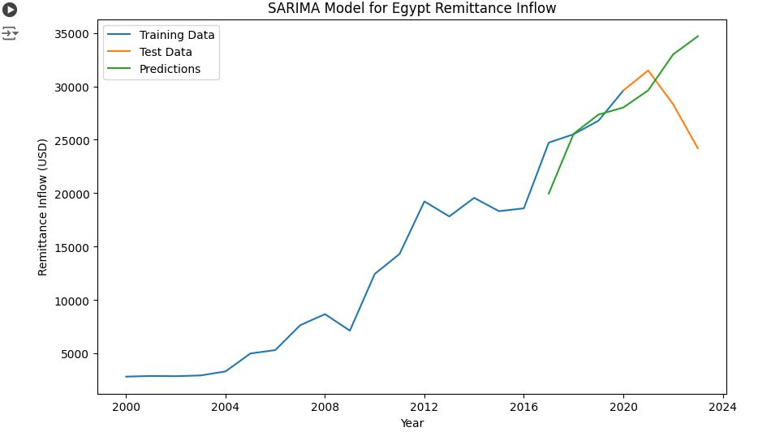
MACHINE LEARNING (SARIMA MODEL)

Slide 10
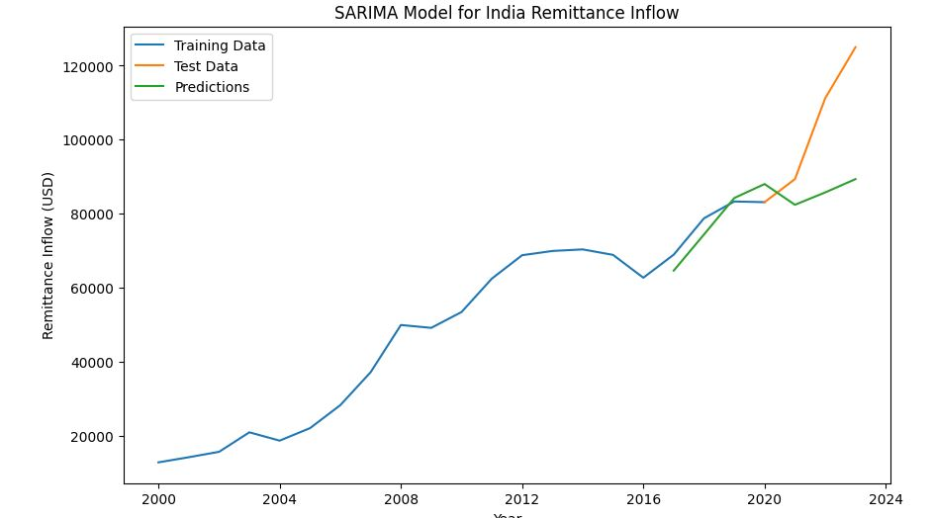
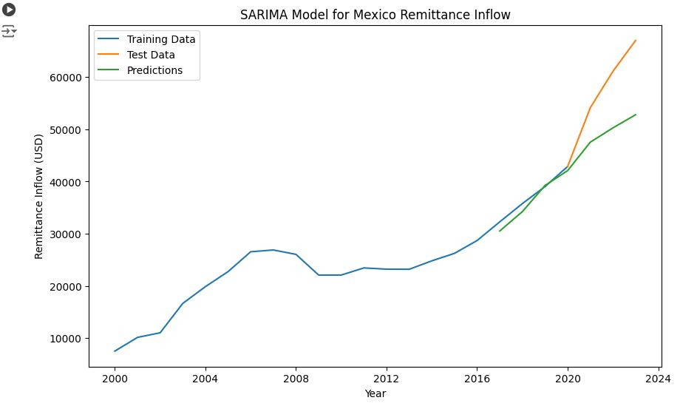
MACHINE LEARNING (SARIMA MODEL cont.)

Slide 11
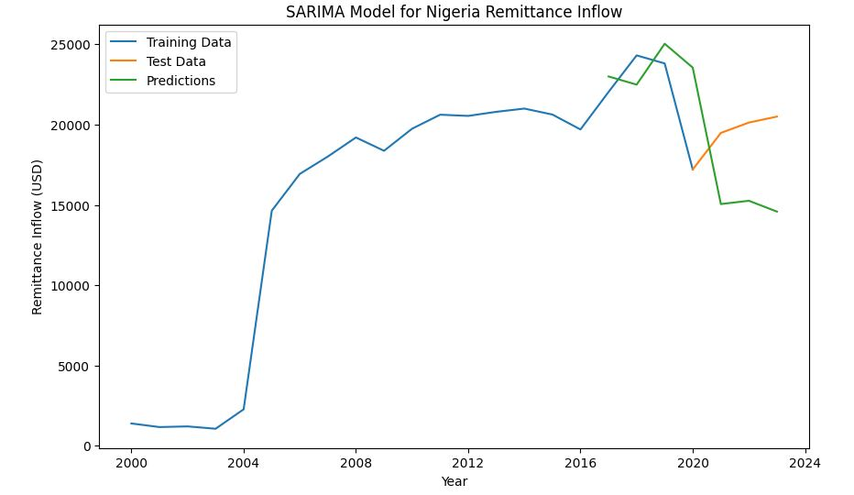
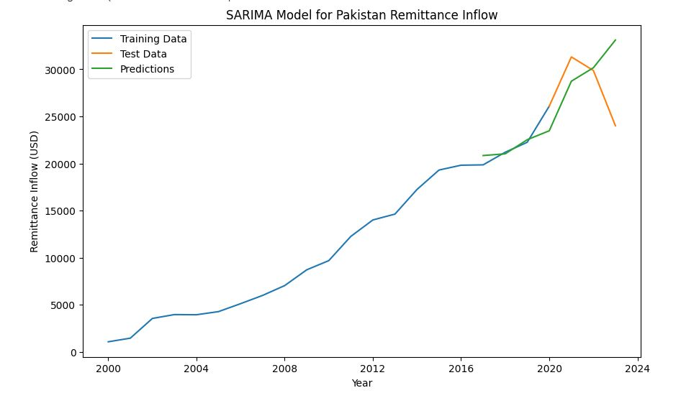
MACHINE LEARNING (SARIMA MODEL cont.)

Slide 12
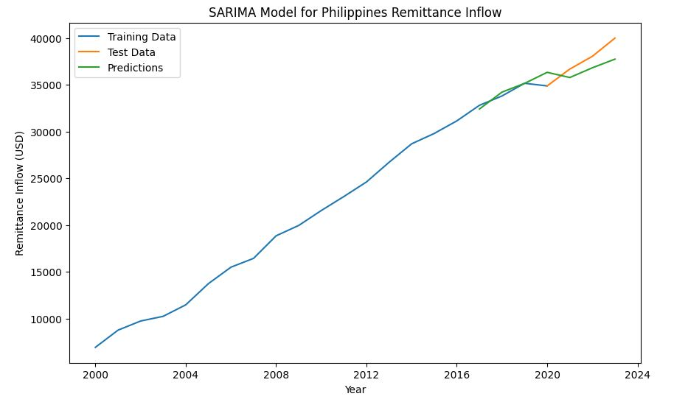
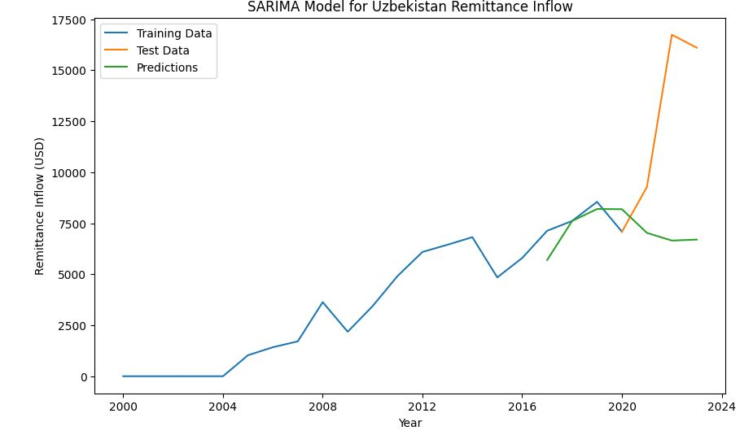
MACHINE LEARNING (SARIMA MODEL cont.)

Slide 13
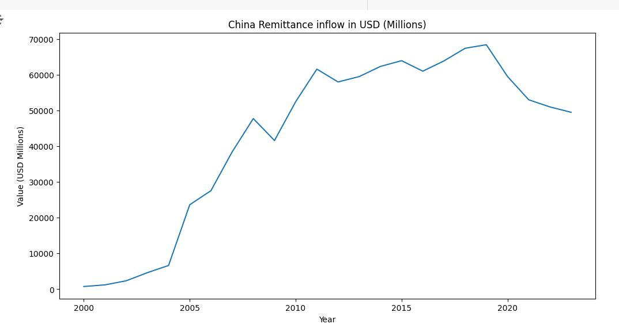
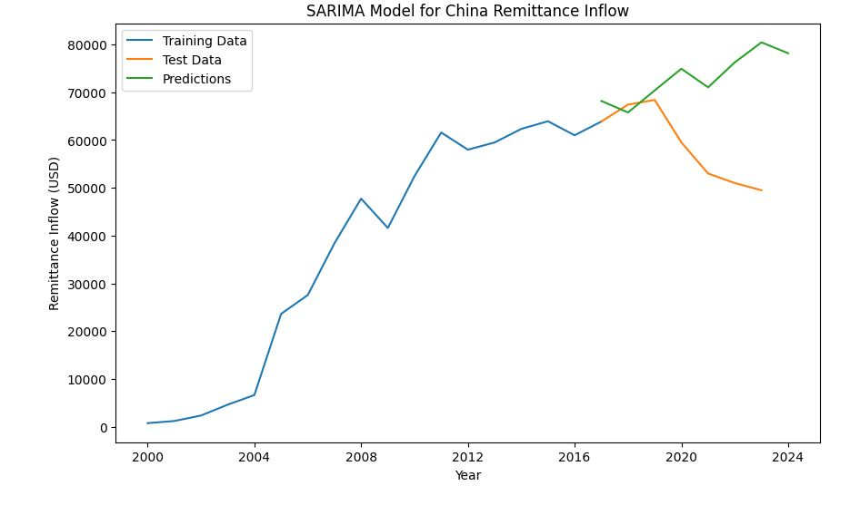
THE CHINA CASE STUDY

Slide 14
CONCLUSION
A clear understanding and projection of the economic impacts facilitated through remittance as
supported by key development indicators is imperative for optimization strategy in a developing society.
Hence, insights gained through this research has the potential to inform policies on migration,
transaction, and technology advancement which influence remittance with resultant increase,
stagnation, or decline.

Slide 15



Meet Our Team
ACTIVE TEAM MEMBERS
Bright Egbo
Barbara Addo
Kwasi Owusu-Nyampong
Yvonne Akpudo
Aisha Hagar
Akanbi Abiodun Olawale
Akash Kundu
Donald Udofia

Slide 16
ANSIBLE GROUP
THANK YOU

